Slide 1
Global HFC phase-down: A major concrete step in delivering the Paris Agreement and in achieving Sustainable Development Goals (SDGs)

Slide 2
Chemical Refrigerants- ODS
From 1930, the use of Chemical refrigerants have been used for refrigeration.
Refrigerants | ODP
R11 (CFC) | 1.0
R12 (CFC) | 0.09
R22 (HCFC) | 0.055
CFCs and HCFCs are used as refrigerants.
But through the 1970s and the 1980s, the international community became increasingly concerned that ODS (Ozone Depleting Substances) would harm the ozone layer.
Chlorofluorocarbons (CFCs), hydrochlorofluorocarbons (HCFCs), halons, and other ozone depleting substances (ODSs) are underlying causes of the observed depletion of the ozone layer and of the ozone hole.

Slide 3
Montreal Protocol- History & Success
In 1985, the Vienna Convention established mechanisms for international co-operation in research into the ozone layer and the effects of ozone depleting chemicals (ODCs). On the basis of the Vienna Convention, the Montreal Protocol on Substances that Deplete the Ozone Layer was negotiated and signed by 24 countries and by the European Economic Community in September 1987. The Protocol called for the Parties to phase down the use of CFCs, halons and other man-made ODCs.
98 percent of the production and consumption of ODSs have been phased out. The ozone layer is projected to recover to its pre-Antarctic ozone holes state over the next 50 years and to its pre-industrial state in about 500 years
Because of measures taken under the Montreal Protocol, emissions of ODS are falling and the ozone layer is expected to be fully healed near the middle of the 21st century.

Slide 5
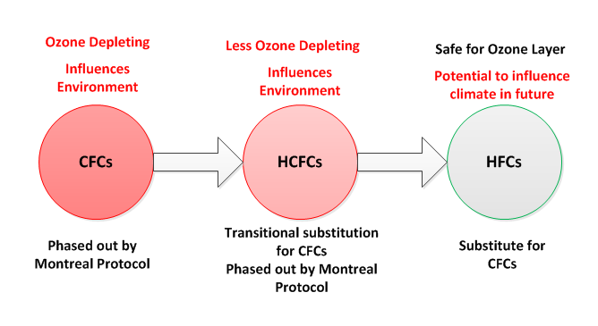
ODS Phase out Process

Slide 6
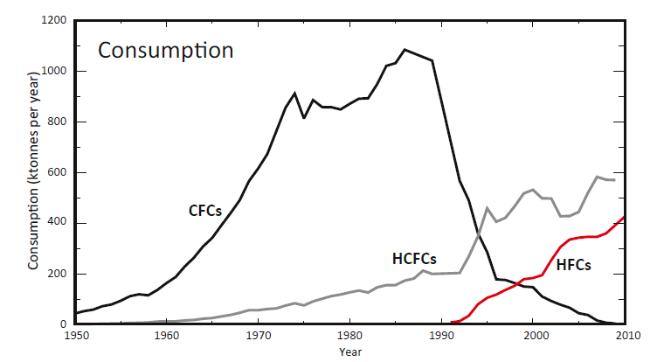
Global trends of Refrigerant Consumption

Slide 7
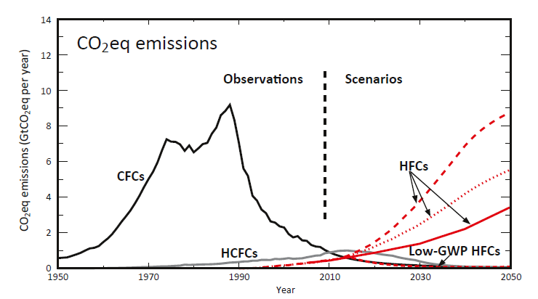
Global Trends of CO2 Emissions

Slide 8
Introduction of HFCs
Under Montreal Protocol, CFCs and HCFCs were replaced with other chemicals such as HFCs, with the eventual aim of developing chemicals and technologies that are ozone-layer-safe and also benign to climate.
R134a
R407C
R 410A
R152a
R 404a

Slide 9
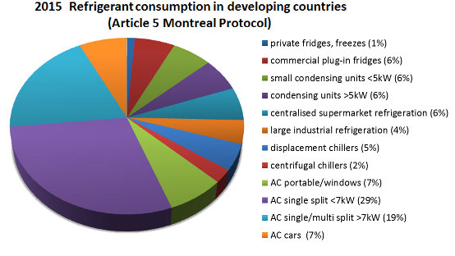
HFCs & its Use

Slide 10
HFC & Global Warming
Though HFCs are not ODS, they are very powerful greenhouse gases, trapping thousands of times more heat in the atmosphere per unit of mass than CO₂.
HFC-134a is the most abundant and fastest growing HFC; it has an atmospheric lifetime of 13-14 years and a global warming potential (GWP) of 1,300.
Notes:
**Myhre G., et al. (2013) Chapter 8: Anthropogenic And Natural Radiative Forcing, In Ipcc (2013) Climate Change 2013: The Physical Science Basis.

Slide 11
HFCs & GWP
GHGs | Lifetime (years) | GWP for given time horizon
 |  | 20 Years | 100 Years | 500 years
CO₂ | 100 | 1 | 1 | 1
CH₄ | 12 | 72 | 25 | 7.6
N₂O | 114 | 289 | 298 | 153
CFC-11 | 45 | 7,020 | 5,350
HFC-134 | 13.8 | 3,300 | 1,300 | 400
SF₆ | 3200 | 16,300 | 22,800 | 32,600

Slide 12
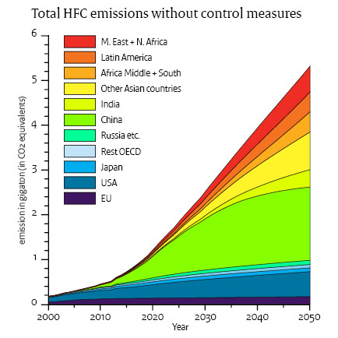
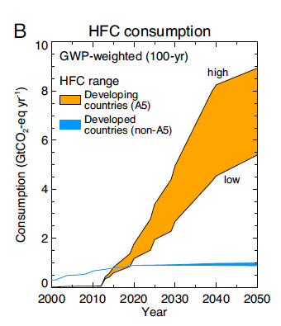
Global HFC Emissions Without Control

Slide 13
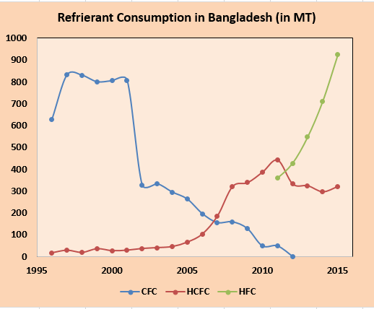
HFC Consumption in Bangladesh
The consumption of HFCs in refrigeration sector in Bangladesh was divided into two broad categories such as manufacturing and servicing.
Broadly, domestic, commercial, industrial and transport refrigeration systems fell under manufacturing categories. Bangladesh has had no facilities to manufacture transport refrigeration system.

Slide 14
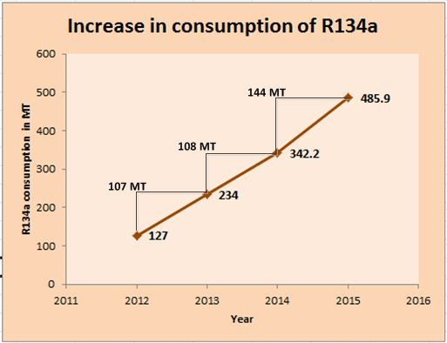
Consumption Trend of R134a in Bangladesh (Source ODS CELL)
In Bangladesh, the most commonly used refrigerant is HFC-134a (R134a). From statistics, it is observed that every year the consumption of R134a is increased by about 100 MT.

Slide 15
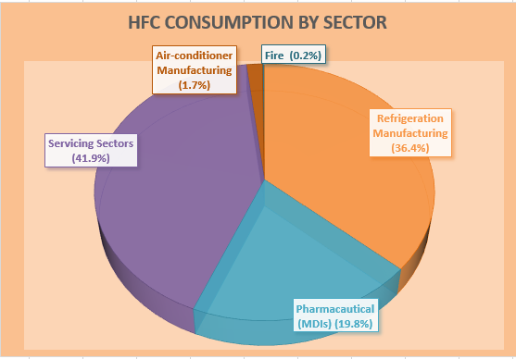
HFC Consumption by Sector in Bangladesh

Slide 16
More HFC Consumption
More Global Warming
So what’s the Solution
How to overcome this issue
What are the developed countries doing to reduce the GHG emission

Slide 17
Looking for Solution
HFC Alternatives- Low GWP Substances
Low-GWP alternatives to high-GWP HFCs are widely and increasingly available
Alternatives to existing high-GWP HFCs fall into two basic categories:
non-fluorinated substances with low-GWP and
fluorinated substances with low- to mid-range GWPs.

Slide 18
HFC Alternatives (contd.)
Commercially available non-fluorinated or “natural refrigerants”:
Ammonia (NH₃)-GWP of near zero
Hydrocarbons (e.g., propane and isobutene)-GWPs of less than four
CO₂ with a GWP of one
Alternative fluorinated substances include primarily the low-GWP HFCs, also known as “HFOs”:
HFC-1234yf –(a GWP100-yr of less than one)
HFC-1234ze –(a GWP100-yr of less than one)
Notes:
1. Carvalho S., et al. (2014) Alternatives To High-Gwp Hydrofluorocarbons; Unep (2011) Hfcs: A Critical Link In Protecting Climate And The Ozone Layer – A Unep Synthesis Report; and Montreal Protocol Technology and Economic Assessment Panel (2009) Task Force Decision XX/8 Report: Assessment of Alternatives to HCFCs and HFCs and Update of the TEAP 2005 Supplement Report Data; Montreal Protocol Technology and Economic Assessment Panel (2010) TEAP 2010 PROGRESS REPORT, VOL. 1 , 27–33.
2. U.S. EPA (2013) Benefits Of Addressing Hfcs Under The Montreal Protocol, Tables 4-6

Slide 19
HFC Alternatives (contd.)
Domestic Refrigeration:
Over 90% of new appliances nowadays contain hydrocarbon refrigerants. In the domestic refrigeration sector..
low-GWP hydrocarbon technology is expected to reach about 75% of global production by 2020.
Notes:
1. UNEP (2011) HFCs: A Critical Link In Protecting Climate And The Ozone Layer – A UNEP Synthesis Report.

Slide 20
HFC Alternatives (contd.)
Commercial Refrigeration:
In large supermarkets refrigeration ("centralized systems")- CO₂ cascade systems are an alternative in cold and moderate climates.
HCs also have proven to be highly efficient alternatives in most applications under high-ambient temperatures, except for larger condensing units.

Slide 21
HFC Alternatives (contd.)
Industrial Refrigeration:
large cooling facility for food processing, ammonia systems have been used

Slide 22
HFC Alternatives (contd.)
Stationary Air Conditioning:
HCs are used as alternative refrigerants in room air conditioning systems in India and China.
For larger systems, pure R32 with a medium-high GWP can be employed as alternative.

Slide 23
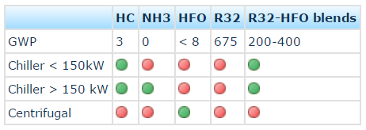
HFC Alternatives (contd.)
For Chillers:
In chillers, the use of hydrocarbons and ammonia are safe and energy-efficient alternatives to HFCs and HCFCs. (both under moderate and high-ambient temperature conditions.)
Newly developed hydrofluoroolefins (HFOs) are already commercially available for use in very large (centrifugal) chillers.

Slide 24
HFC Alternatives (contd.)
Mobile Air Conditioning:
The refrigerant HFC-134a used so far in air conditioning of cars..
However, that is being substituted in new car models as a consequence of the European Directive on mobile air-conditioning systems (MAC Directive).
Alternative refrigerant s including CO₂ and the HFO (R1234yf) been introduced in certain car models recently.

Slide 25
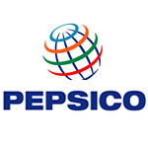
Global Scenario
A number of global companies that are already making the transition away from HFCs report significant gains in energy efficiency.

Slide 26
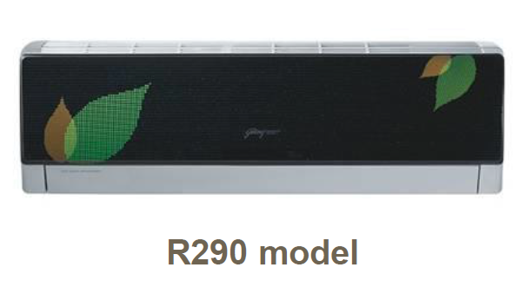
Case Study-1
Godrej & Boyce HC-290 room A/Cs in India
The Indian appliance manufacturer developed the R-290 AC for India.
Godrej choose HC-290 for its superior thermodynamic properties at high ambient temperatures compared to HFC-410a.
Godrej, with the support of GIZ, designed 1.0 and 1.5 ton R-290 based A/Cs.
These are sold at prices comparable to room A/Cs with the same energy rating based on HCFC-22, HFC-410a and HFC-32.

Slide 27
Case Study-1 (Contd.)
Godrej has sold over 100,000 HC-290 room A/Cs manufactured in a facility with a production capacity of 180,000 R-290 based A/Cs per year.
Achieved the highest (five star) energy efficiency rating awarded by India’s Bureau of Energy Efficiency (BEE)

Slide 28
Case Study-2
Coca-Cola’s HFC free Cooler
Coca Cola Company is gradually phasing out the use of HFC refrigerants in our cold-drink equipment across their global value chain.
Upto 2014, The Coca-Cola Company has installed 1 million hydrofluorocarbon (HFC)-free cooler using natural refrigerant in the marketplace.
This has prevented the emission of 5.25 million metric tons of CO2 over 10 years.

Slide 29
Case Study-2 (contd.)
Coca-Cola has improved its cooling equipment energy efficiency by 40 percent since 2000;
eliminated 75 percent of direct greenhouse gas (GHG) emissions by transitioning to HFC-free insulation foam for new equipment.
In 2013, Coca-Cola placed approximately 230,000 units of HFC-free equipment, bringing the global total to 1 million.
Together with its bottling partners, the Coca-Cola system has established a goal that all new cold-drink equipment will be HFC-free by 2015.

Slide 30
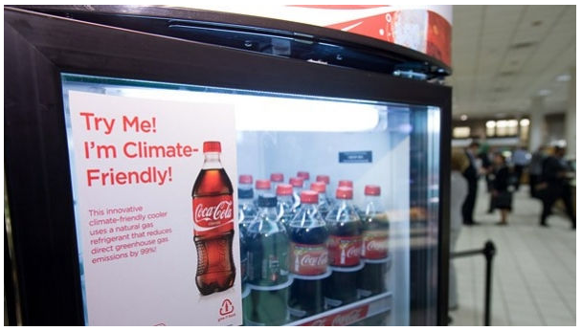

Slide 31
Bangladesh Current Situation
Bangladesh accessed to the Montreal Protocol on 2nd August 1990 and ratified its subsequent amendments. It established an “Ozone Cell” in the Department of Environment. It undertook a reconnaissance study on import and consumption of ODSs in 1993.
Bangladesh has made its National Phase-out Plan targeting Zero import of CFC's in 2010.
“Bangladesh is partner of the Climate and Clean Air Coalition to Reduce Short-Lived Climate Pollutants (CCAC), an initiative of the United Nations Environment Programme (UNEP) and a group of countries launched in 2012 for a collective action to reduce short-lived climate pollutants (SLCPs) such as black carbon (soot), methane and some hydrofluorocarbons (HFC).”
Bangladesh ratified the United Nations Framework Convention for Climate Change (UNFCCC) and the Kyoto Protocol.
The good news is that HFC alternatives are already been introduced in Bangladesh. Though the quantity is very less (~1%), R600a (Isobutane) is been used in few sectors from 2015-16.

Slide 32
Movements of Bangladesh
On 2 August, 1990, Bangladesh signed the Montreal protocol.
Amendments of the protocol from London, Copenhagen, Montreal and Beijing been approved in 1994, 2000, 2001 and 2010 respectively.
In the period of 1995-2015, a nationwide survey has been carried out to determine the consumption of ozone depleting substances (ODS).
The usage of CFC has been completely phased out in 2012.
The usage of HCFC-22 started massively in 2012 due to the increasing use of air cooler.
In 2013, Bangladesh completely phased out the use of HCFC-141b from the foam sector and started using Cyclopentane as an eco-friendly alternate technology.
In 2015, Bangladesh reduced the use of HCFC by 10% which was one of the targets of Montreal Protocol.

Slide 33
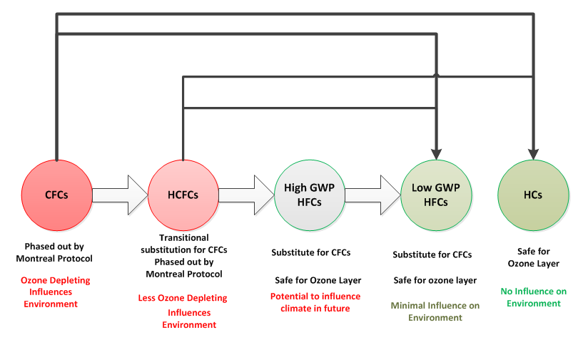
Future Strategies

Slide 34
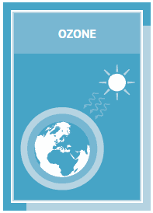
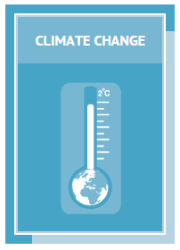
Challenges to Overcome
To make people aware about the impact of HFCs on climate
To encourage people about using new alternatives
To ensure govt. participation in phasing down of HFC consumption
To develop R&D for enhancing knowledge on HFC alternatives

Slide 35
Thank you

