Slide 1
Capacity Building Workshop on HFC Phase Down : An Initiative to Reduce Global Warming Date: 18 October 2016 Venue: The Daily Star Conference Room, Dhaka.
HFC and Global Warming
Presented by
Mohammad Reazuddin

Slide 2
List of GHGs and ODSs
GHGs | ODSs
Carbon dioxide | CFCs
Methane | Halons
Fluorinated gases | Methyl bromide
Nitrous Oxide | HCFCs
 | Carbon tetrachloride

Slide 3
Who Controls What?
ODSs
Vienna Convention
Montreal Protocol
Amendments of Montreal Protocol
Kigali Amendment
GHGs
UNFCCC
Kyoto Protocol
Paris Agreement

Slide 4
Interaction of GHGs and ODSs

Slide 5
Is there any interaction between climate protocols and ozone protocol?

Slide 6
How did Montreal Protocol attain the success?
Phasing out of CFCs and HCFC
Now, replacing HCFCs by HFCs
Ultimately it has saved the ozone layer but harming the climate

Slide 7
HFC are under now dual control

Slide 8
What are HFC and where they are used?
HFCs are hydro fluorocarbons. About 3,800 times more potent than CO2 with a lifetime of 14 years
Uses
Refrigeration and air-conditioning
Foam
Solvent
Fire fighting
Aerosol
MDI etc.

Slide 9
Use of HFCs in Bangladesh
Domestic Refrigeration Manufacturing
Commercial/Industrial Refrigeration Manufacturing
Industrial air-conditioning including chillers
Transport Refrigeration manufacturing
Residential Air-conditioner manufacturing
Commercial/ Industrial Chiller manufacturing
Mobile Air-conditioner manufacturing
Fire Extinguishers manufacturing
Pharmaceutical Applications (MDIs)
Service sector (for all applications)

Slide 10
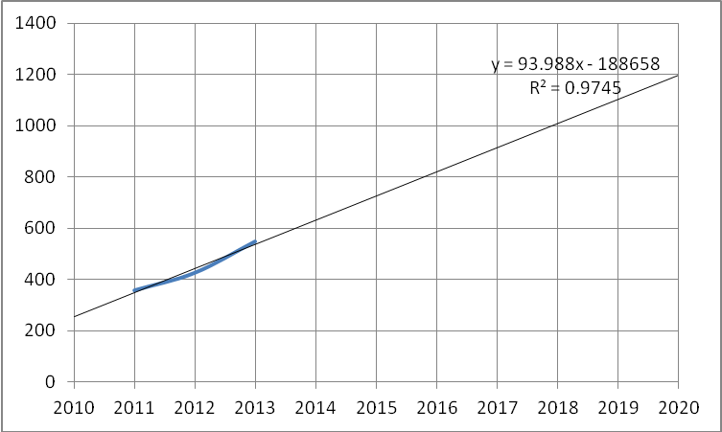
Projections of HFCs Use

Slide 11
The potential threat of HFCs and global warming
Currently it is around 2% of total GHG emission in terms of CO2 equivalent
Within next 20 to 30 years, it is projected to occupy around 20% of the total GHG emission, if HFC uses are continued as business usual

Slide 12
Climate friendly alternatives of HFCs and HCFCs
Hydrocarbons
HFOs
Not in kind technology
Ammonia
carbon dioxide etc.

Slide 13
Barriers and constraints
Technology transfer
Capacity building
Financing
SMEs?
MDI

Slide 14
Thanks

